Slide 1
Analysis on Indian Liver Patients
Analysis done by,
Nivedita Kowlagi
Sheetal Pawar
Shrutika Deshpande

Slide 2
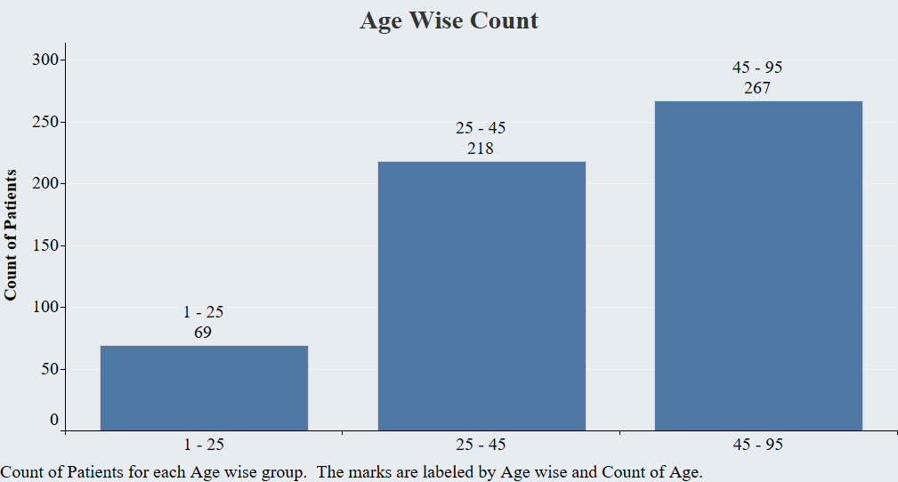

Slide 3
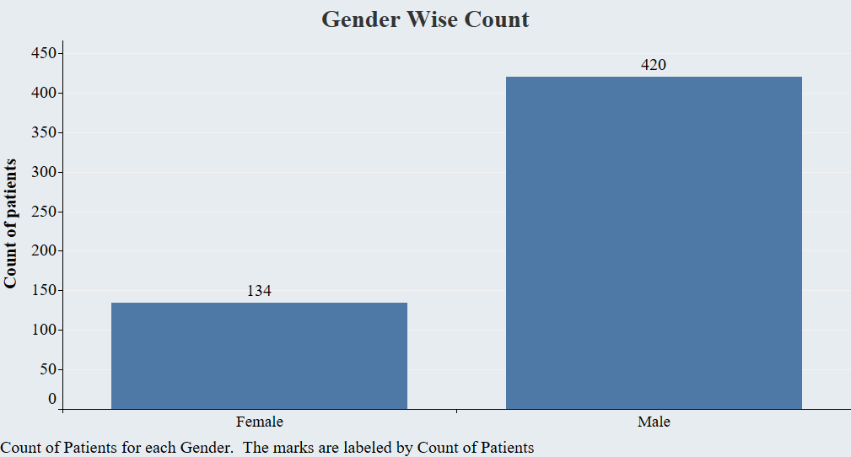

Slide 4
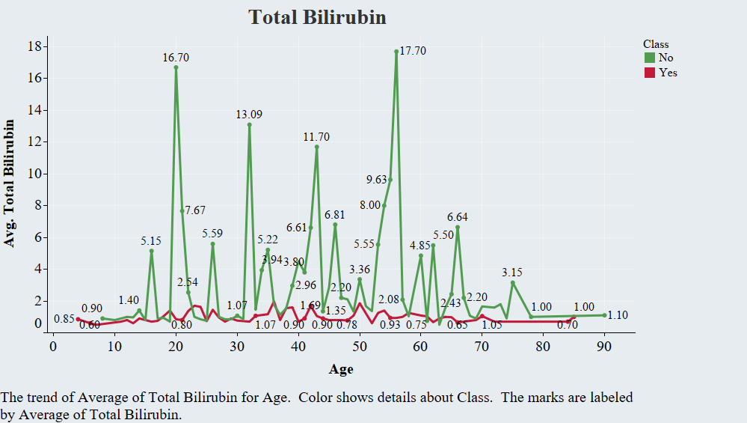

Slide 5
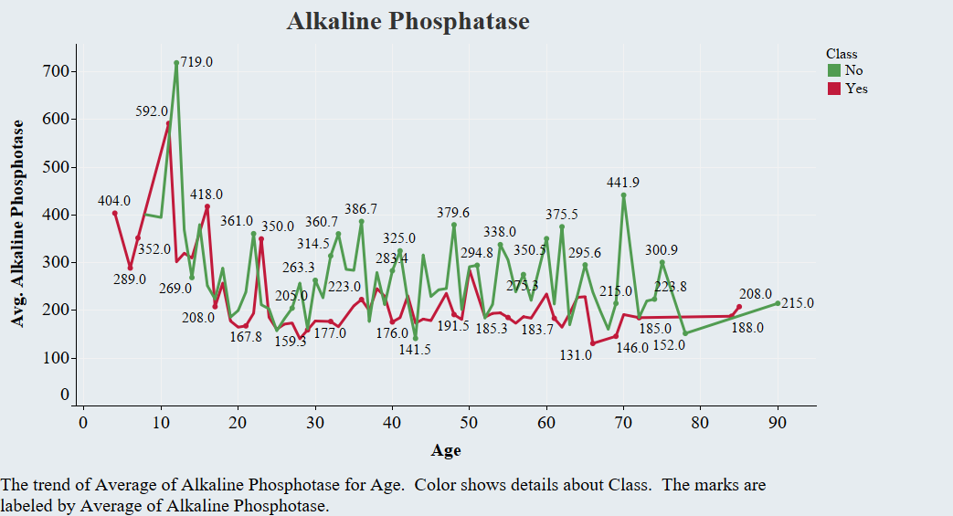

Slide 6
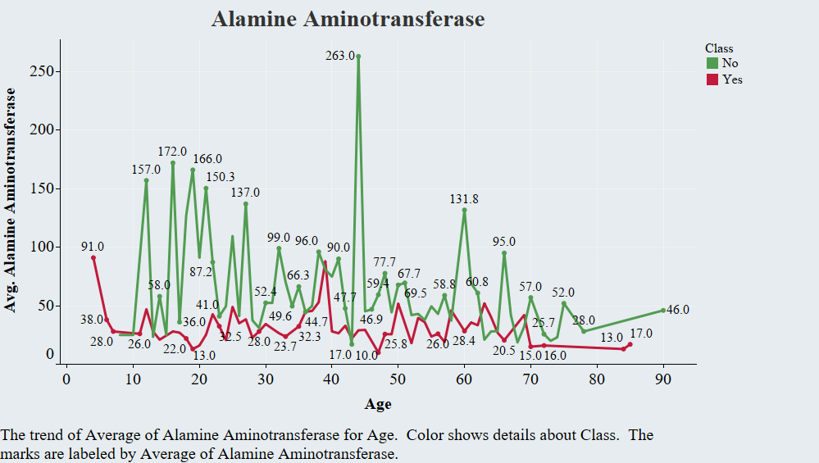

Slide 7
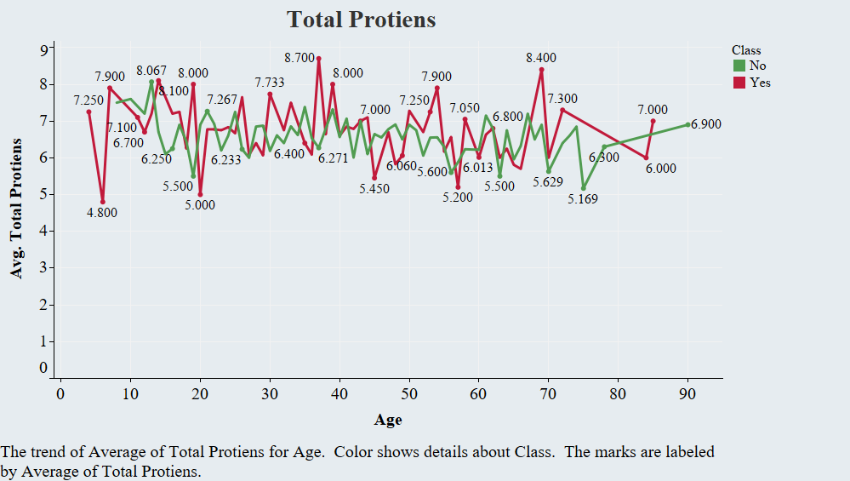

Slide 8
